Slide 1

Framework to Manage Risk
Confidential
Created by ex-McKinsey, Deloitte & BCG Management Consultants specialized in Risk Management

Slide 2







This deliverable will focus on the phase II till VII of our Risk Management Approach
Practical Framework to Manage Risks
1.Risk Management Strategy & Plan
2.Risk Identification
3.Risk Assessment
4.Risk Prioritization
5.Risk Mitigation
6.Risk Closure and Issue Escalation
7. Issue Management

Slide 3
Introduction
You can directly use this deliverable for your own purposes. You’ll simply have to insert your logo and adjust the slides based on the specificities of your organization.
Please note that this document also includes many slides with best practices, tutorials, and real-life examples to help you adjust this deliverable based on the specificities of your organization. These slides includes an orange rectangle on their top right corner. You may decide to delete these slides as they are mainly here to help you fill in the rest of the deliverable. Before you do so, copy paste this document, so you always have the original version in case you need it.

Slide 4





Table of contents
1.Risk Management Strategy & Plan
2.Risk Identification
3.Risk Assessment
4.Risk Prioritization
5.Risk Mitigation
6.Risk Closure and Issue Escalation
7. Issue Management
Summary of the corporate and business strategy
Risk appetite
Risk management capability maturity model
Risk management mission, vision and strategic objectives
Risk management KPIs, targets and initiatives
Roadmap to reach our strategic objectives
Risk management team and budget
Governance structure
Guiding principles
Framework to manage risk
Risk types and examples
Tools to identify risks
Simple risk log in Powerpoint
Comprehensive risk log in Excel
Probability of the risk to happen
Potential impact of the risk
Risk value
3 by 3 risk prioritization matrix in Powerpoint and Excel
5 by 5 risk prioritization matrix in Powerpoint and Excel
Response options
Examples
Actions, deadlines and responsibilities
Dashboard
Risk closure
Issue escalation
Simple issue log in Powerpoint
Comprehensive issue log in Excel

Slide 5
Table of contents
1.Risk Management Strategy & Plan
2.Risk Identification
3.Risk Assessment
4.Risk Prioritization
5.Risk Mitigation
6.Risk Closure and Issue Escalation
7. Issue Management
Summary of the corporate and business strategy
Risk appetite
Risk management capability maturity model
Risk management mission, vision and strategic objectives
Risk management KPIs, targets and initiatives
Roadmap to reach our strategic objectives
Risk management team and budget
Governance structure
Guiding principles
Framework to manage risk
Risk types and examples
Tools to identify risks
Simple risk log in Powerpoint
Comprehensive risk log in Excel
Probability of the risk to happen
Potential impact of the risk
Risk value
3 by 3 risk prioritization matrix in Powerpoint and Excel
5 by 5 risk prioritization matrix in Powerpoint and Excel
Response options
Examples
Actions, deadlines and responsibilities
Dashboard
Risk closure
Issue escalation
Simple issue log in Powerpoint
Comprehensive issue log in Excel

Slide 6



There are mainly 4 types of Risks that we will have to identify
Operational risks
Supply Chain Issues
Commodity prices
Product quality
Strategic risks
Pricing pressure
Industry downturn
Demand shift
Financial risks
Debt
Interest rates
Profit margin
Hazard risks
Natural disasters
Political instability
Terrorism

Slide 7
Table of contents
1.Risk Management Strategy & Plan
2.Risk Identification
3.Risk Assessment
4.Risk Prioritization
5.Risk Mitigation
6.Risk Closure and Issue Escalation
7. Issue Management
Summary of the corporate and business strategy
Risk appetite
Risk management capability maturity model
Risk management mission, vision and strategic objectives
Risk management KPIs, targets and initiatives
Roadmap to reach our strategic objectives
Risk management team and budget
Governance structure
Guiding principles
Framework to manage risk
Risk types and examples
Tools to identify risks
Simple risk log in Powerpoint
Comprehensive risk log in Excel
Probability of the risk to happen
Potential impact of the risk
Risk value
3 by 3 risk prioritization matrix in Powerpoint and Excel
5 by 5 risk prioritization matrix in Powerpoint and Excel
Response options
Examples
Actions, deadlines and responsibilities
Dashboard
Risk closure
Issue escalation
Simple issue log in Powerpoint
Comprehensive issue log in Excel

Slide 8
Key tools to help us identify risks PESTLE
The PESTLE Tool will help us analyze the environment in which our Business operates

Slide 9
Key tools to help us identify risks PESTLE
P
Political
T
Technological
E
Economic
L
Legal
S
Sociological
E
Environmental

Slide 10
Key tools to help us identify risks PESTLE
P
Insert here any political factors that impact or could potentially impact the Business. These political factors can be local, national or international
Examples: A new government, a new initiative, a change of policy, etc.
T
Insert here any Technological factors that impact or could potentially impact the Business
Examples: A new software, device, patents, etc.
E
Insert here any Economical factors that impact or could potentially impact the Business
Examples: A change in disposable income, an economic downturns, the availability of bank loans, etc.
L
Insert here any Legal factors that impact or could potentially impact the Business
Examples: International selling laws, health and safety requirement, Data protection, competitive regulations, employment law, etc.
S
Insert here any Sociological factors that impact or could potentially impact the Business
Examples: The demographic change of a company’s customers, a change in the cultural habits of the population, a change in lifestyle, etc.
E
Insert here any Environmental factors that impact or could potentially impact the Business
Examples: the use of plastic bags for goods, the use of electrical cars, customer values, environmental regulations, etc.

Slide 11






Key tools to help us identify risks PESTLE
Additional template you may prefer to use
Political
Insert your own text
Technological
Insert your own text
Economic
Insert your own text
Legal
Insert your own text
Sociological
Insert your own text
Environmental
Insert your own text

Slide 12
Key tools to help us identify risks PESTLE
Additional template you may prefer to use
Replace the text by your own text
Replace the text by your own text
Replace the text by your own text
Replace the text by your own text
Replace the text by your own text
Replace the text by your own text
Replace the text by your own text
Replace the text by your own text
Replace the text by your own text
Replace the text by your own text
Environment
Political
Replace the text by your own text
Replace the text by your own text
Replace the text by your own text
Replace the text by your own text
Replace the text by your own text
Replace the text by your own text
Replace the text by your own text
Replace the text by your own text
Replace the text by your own text
Replace the text by your own text
Legal
Economic
PESTLE
Technology
Sociological
Replace the text by your own text
Replace the text by your own text
Replace the text by your own text
Replace the text by your own text
Replace the text by your own text
Replace the text by your own text
Replace the text by your own text
Replace the text by your own text
Replace the text by your own text
Replace the text by your own text

Slide 13
Key tools to help us identify risks PESTLE
Additional template you may prefer to use
Political
Replace the text by your own text
Replace the text by your own text
Replace the text by your own text
Replace the text by your own text
P
T
Technological
Replace the text by your own text
Replace the text by your own text
Replace the text by your own text
Replace the text by your own text
Economical
Replace the text by your own text
Replace the text by your own text
Replace the text by your own text
Replace the text by your own text
E
L
Legal
Replace the text by your own text
Replace the text by your own text
Replace the text by your own text
Replace the text by your own text
Social
Replace the text by your own text
Replace the text by your own text
Replace the text by your own text
Replace the text by your own text
S
E
Environmental
Replace the text by your own text
Replace the text by your own text
Replace the text by your own text
Replace the text by your own text

Slide 14
Key tools to help us identify risks SWOT
The SWOT tool is useful to analyze a business or industry's internal Strengths and Weaknesses and external Opportunities and Threats.

Slide 15
Key tools to help us identify risks SWOT
Threats
T
T
SWOT
S
Strengths
s
W
Weaknesses
O
Opportunities

Slide 16
Key tools to help us identify risks SWOT
Describe factors that have the potential to harm your Organization. For example, a drought is a threat to a wheat-producing company, as it may destroy or reduce the crop yield. Other common threats include things like rising costs for materials, increasing competition, tight labor supply, etc.
Describe what is stopping your Organization from performing at its optimum level: a weak brand, high levels of debt, an underperforming supply chain, etc.
Threats
T
T
SWOT
S
Strengths
s
W
Weaknesses
Describe what your Organization excels at and what separates it from the competition: a strong brand, loyal customer base, a strong balance sheet, unique technology, etc.
Describe favorable external factors that could give your organization a competitive advantage. For example, if a country cuts tariffs, a car manufacturer can export its cars into a new market.
O
Opportunities

Slide 17
Key tools to help us identify risks SWOT
Additional template you may prefer to use
Strengths
Weaknesses
Insert you own text
Insert you own text
Insert you own text
Insert you own text
Insert you own text
Insert you own text
Opportunities
Threats
Insert you own text
Insert you own text
Insert you own text
Insert you own text
Insert you own text
Insert you own text

Slide 18
Key tools to help us identify risks SWOT
Additional template you may prefer to use
Strengths
Weaknesses
Insert you own text
Insert you own text
Insert you own text
Insert you own text
Insert you own text
Insert you own text
Internal
Opportunities
Threats
Insert you own text
Insert you own text
Insert you own text
Insert you own text
Insert you own text
Insert you own text
External

Slide 19
Key tools to help us identify risks SWOT
Additional template you may prefer to use
Helpful
Harmful
Strengths
Insert you own text
Insert you own text
Insert you own text
Weaknesses
Insert you own text
Insert you own text
Insert you own text
Outside the organization
Opportunities
Insert you own text
Insert you own text
Insert you own text
Threats
Insert you own text
Insert you own text
Insert you own text
Inside the organization

Slide 20
Key tools to help us identify risks SWOT
Additional template you may prefer to use
Strengths
Insert your own text
Insert your own text
Insert your own text
SWOT
Weaknesses
Insert your own text
Insert your own text
Insert your own text
Opportunities
Insert your own text
Insert your own text
Insert your own text
Threats
Insert your own text
Insert your own text
Insert your own text

Slide 21




Key tools to help us identify risks SWOT
Additional template you may prefer to use
Strengths
Insert your own text
Insert your own text
Insert your own text
SWOT
Weaknesses
Insert your own text
Insert your own text
Insert your own text
Opportunities
Insert your own text
Insert your own text
Insert your own text
Threats
Insert your own text
Insert your own text
Insert your own text

Slide 22
Key tools to help us identify risks SWOT
Additional template you may prefer to use
Strengths
Insert your own text
Insert your own text
Insert your own text
Insert your own text
Insert your own text
Insert your own text
Insert your own text
Insert your own text
Weaknesses
Insert your own text
Insert your own text
Insert your own text
Insert your own text
Insert your own text
Insert your own text
Insert your own text
Insert your own text
Opportunities
Insert your own text
Insert your own text
Insert your own text
Insert your own text
Insert your own text
Insert your own text
Insert your own text
Insert your own text
Threats
Insert your own text
Insert your own text
Insert your own text
Insert your own text
Insert your own text
Insert your own text
Insert your own text
Insert your own text

Slide 23
Key tools to help us identify risks Fishbone diagram
A fishbone diagram, also called a cause-and-effect diagram or Ishikawa diagram, is a visualization tool for categorizing the potential causes of a problem in order to identify its root causes

Slide 24
Key tools to help us identify risks Fishbone diagram
Cause #5
Cause #3
Cause #1
Causes
Effects
Cause #5.1
Cause #3.1
Cause #1.1
Start by writing the main problem or issue to be studied
Your own text
Your own text
Cause #5.2
Cause #3.2
Cause #1.2
Key problem
Cause #6.1
Cause #4.1
Cause #2.1
Cause #6.2
Cause #4.2
Cause #2.2
Causes that contribute to the problem
Your own text
Your own text
Cause #6
Cause #4
Cause #2

Slide 25
Key tools to help us identify risks Fishbone diagram
Sample
Text
Sample
Text
Sample
Text
Your own text
Your own text
Your own text
Your own text
Your own text
Your own text
Your own text
Your own text
Sample Text
Your own text
Your own text
Your own text
Your own text
Your own text
Your own text
Your own text
Your own text
Sample
Text
Sample
Text
Sample
Text

Slide 26
Table of contents
1.Risk Management Strategy & Plan
2.Risk Identification
3.Risk Assessment
4.Risk Prioritization
5.Risk Mitigation
6.Risk Closure and Issue Escalation
7. Issue Management
Summary of the corporate and business strategy
Risk appetite
Risk management capability maturity model
Risk management mission, vision and strategic objectives
Risk management KPIs, targets and initiatives
Roadmap to reach our strategic objectives
Risk management team and budget
Governance structure
Guiding principles
Framework to manage risk
Risk types and examples
Tools to identify risks
Simple risk log in Powerpoint
Comprehensive risk log in Excel
Probability of the risk to happen
Potential impact of the risk
Risk value
3 by 3 risk prioritization matrix in Powerpoint and Excel
5 by 5 risk prioritization matrix in Powerpoint and Excel
Response options
Examples
Actions, deadlines and responsibilities
Dashboard
Risk closure
Issue escalation
Simple issue log in Powerpoint
Comprehensive issue log in Excel

Slide 27
Simple Risk Log Description
To identify our company risks and project risks, we created a simple Risk Log in Powerpoint.
This simple Risk Log will be used when our list of risks is small or if we need to make a presentation in front of our Board of Directors, Executive Committee or any stakeholders that do not need to know too many details.

Slide 28
Simple Risk Log 3-level rating
Low priority (Risk value is 1, 2 or 3)
Medium priority (Risk value is 6)
High priority (Risk value is 9)
Risk # | Risk Title | Risk description | Impact (1=Minor; 2=Moderate; 3=Major) | Probability (1=Unlikely; 2=Possible; 3=Likely) | Risk Value (Impact X Probability) | Mitigation Strategy | Assigned to
1 | Lower website speed | Improving the resolution of our images will increase the size of our images, which may lower our website page loading time | 3 | 3 | 9 | Find the sweet spot between quality images and page loading time | Donald
2 | High oil price | A strong increase in oil price would create a high pressure on our profit margins | 1 | 2 | 2 | Buy more oil than we need to build up our stock while the price of oil is at an affordable price | Ralph
3 | Insert your risk title | Insert your risk description | 2 | 3 | 6
4 | Insert your risk title | Insert your risk description | Rate from 1 to 3 | Rate from 1 to 3
5 | Insert your risk title | Insert your risk description | Rate from 1 to 3 | Rate from 1 to 3
6 | Insert your risk title | Insert your risk description | Rate from 1 to 3 | Rate from 1 to 3
7 | Insert your risk title | Insert your risk description | Rate from 1 to 3 | Rate from 1 to 3

Slide 29
Simple Risk Log 5-level rating
Low priority (Risk value ≤ 5)
Medium priority (Risk value is between 6 & 14)
High priority (Risk value is >=15)
Risk # | Risk Title | Risk description | Impact (1=Marginal; 2=Minor; 3=Moderate; 4=Major; 5=Severe) | Probability (1=Rare; 2=Unlikely; 3=Possible; 4=Likely; 5=Almost certain) | Risk Value (Impact X Probability) | Mitigation Strategy | Assigned to
1 | Lower website speed | Improving the resolution of our images will increase the size of our images, which may lower our website page loading time | 5 | 4 | 20 | Find the sweet spot between quality images and page loading time | Donald
2 | High oil price | A strong increase in oil price would create a high pressure on our profit margins | 1 | 2 | 2 | Buy more oil than we need to build up our stock while the price of oil is at an affordable price | Ralph
3 | Insert your risk title | Insert your risk description | 2 | 3 | 6
4 | Insert your risk title | Insert your risk description | Rate from 1 to 3 | Rate from 1 to 3
5 | Insert your risk title | Insert your risk description | Rate from 1 to 3 | Rate from 1 to 3
6 | Insert your risk title | Insert your risk description | Rate from 1 to 3 | Rate from 1 to 3
7 | Insert your risk title | Insert your risk description | Rate from 1 to 3 | Rate from 1 to 3

Slide 30
Table of contents
1.Risk Management Strategy & Plan
2.Risk Identification
3.Risk Assessment
4.Risk Prioritization
5.Risk Mitigation
6.Risk Closure and Issue Escalation
7. Issue Management
Summary of the corporate and business strategy
Risk appetite
Risk management capability maturity model
Risk management mission, vision and strategic objectives
Risk management KPIs, targets and initiatives
Roadmap to reach our strategic objectives
Risk management team and budget
Governance structure
Guiding principles
Framework to manage risk
Risk types and examples
Tools to identify risks
Simple risk log in Powerpoint
Comprehensive risk log in Excel
Probability of the risk to happen
Potential impact of the risk
Risk value
3 by 3 risk prioritization matrix in Powerpoint and Excel
5 by 5 risk prioritization matrix in Powerpoint and Excel
Risk management dashboard
Response options
Examples
Actions, deadlines and responsibilities
Dashboard
Risk closure
Issue escalation
Simple issue log in Powerpoint
Comprehensive issue log in Excel

Slide 31

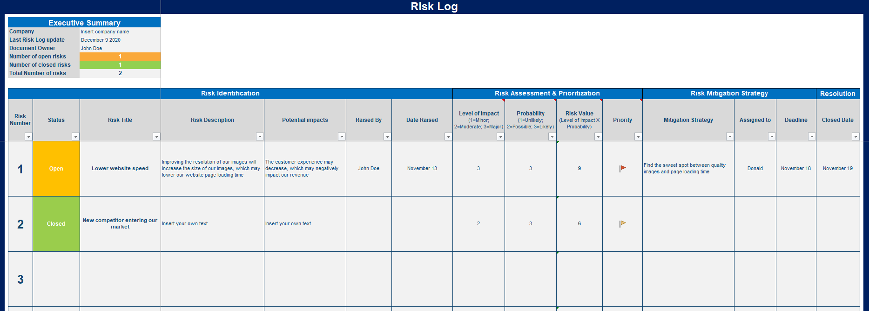
Comprehensive Risk Log Description
To identify our company risks and project risks, we created a comprehensive Risk Log in Excel.
This comprehensive Risk Log in Excel will be used when we have a long list of risks and need to provide a lot of details for each one of them.
Comprehensive Risk Log in Excel (for more details, open the Excel document “Comprehensive Risk Log”

Slide 32

Table of contents
1.Risk Management Strategy & Plan
2.Risk Identification
3.Risk Assessment
4.Risk Prioritization
5.Risk Mitigation
6.Risk Closure and Issue Escalation
7. Issue Management
Summary of the corporate and business strategy
Risk appetite
Risk management capability maturity model
Risk management mission, vision and strategic objectives
Risk management KPIs, targets and initiatives
Roadmap to reach our strategic objectives
Risk management team and budget
Governance structure
Guiding principles
Framework to manage risk
Risk types and examples
Tools to identify risks
Simple risk log in Powerpoint
Comprehensive risk log in Excel
Probability of the risk to happen
Potential impact of the risk
Risk value
3 by 3 risk prioritization matrix in Powerpoint and Excel
5 by 5 risk prioritization matrix in Powerpoint and Excel
Response options
Examples
Actions, deadlines and responsibilities
Dashboard
Risk closure
Issue escalation
Simple issue log in Powerpoint
Comprehensive issue log in Excel

Slide 33
To assess our corporate risks or project risks correctly, it is important to use the following 2 dimensions
Probability
Impact
What is the probability of the risk to happen
What is the potential impact of the Risk
&

Slide 34
By multiplying the dimension “Probability” by the dimension “Impact”, we will get our “Risk Value”
Probability
Impact
Risk Value
What is the probability of the risk to happen
What is the potential impact of the risk
The risk value will help you prioritize your risks
X
=

Slide 35
To assess the Probability of a risk to happen, we can use a 3-level rating or a 5-level rating depending on our needs
Probability 3-level rating
Probability Scale
Definition
3.Likely
Above 60% of chances to happen
2.Possible
Between 20% and 60% of chances to happen
1.Unlikely
Less than 20% of chances to happen

Slide 36
To assess the Probability of a risk to happen, we can use a 3-level rating or a 5-level rating depending on our needs
Probability 5-level rating
Probability Scale
Definition
5.Almost certain
Above 90% of chances to happen
4.Likely
Between 60% and 90% of chances to happen
3.Possible
Between 20% and 60% of chances to happen
2.Unlikely
Between 5% and 20% of chances to happen
1.Rare
Less than 5% of chances to happen

Slide 37
To assess the Potential Impact of a risk, we can use a 3-level rating or a 5-level rating depending on our needs
“Impact” 3-level rating
Impact Scale
Definition
3.Major
Risk will impact project success or company success
2.Moderate
Risk may impact project success or company success
1.Minor
Barely no impact on project success or company success

Slide 38
To assess the Potential Impact of a risk, we can use a 3-level rating or a 5-level rating depending on our needs
“Impact” 5-level rating
Impact Scale
Definition
5.Severe
Risk will cause Project failure or Company failure
4.Major
Risk will impact project success or company success
3.Moderate
Risk may impact project success or company success
2.Minor
Barely no impact on project success or company success
1.Marginal
No impact on project success or company success

Slide 39
Table of contents
1.Risk Management Strategy & Plan
2.Risk Identification
3.Risk Assessment
4.Risk Prioritization
5.Risk Mitigation
6.Risk Closure and Issue Escalation
7. Issue Management
Summary of the corporate and business strategy
Risk appetite
Risk management capability maturity model
Risk management mission, vision and strategic objectives
Risk management KPIs, targets and initiatives
Roadmap to reach our strategic objectives
Risk management team and budget
Governance structure
Guiding principles
Framework to manage risk
Risk types and examples
Tools to identify risks
Simple risk log in Powerpoint
Comprehensive risk log in Excel
Probability of the risk to happen
Potential impact of the risk
Risk value
3 by 3 risk prioritization matrix in Powerpoint and Excel
5 by 5 risk prioritization matrix in Powerpoint and Excel
Response options
Examples
Actions, deadlines and responsibilities
Dashboard
Risk closure
Issue escalation
Simple issue log in Powerpoint
Comprehensive issue log in Excel

Slide 40
Our risk prioritization will depend on our risk value. The Risks with the highest risk value should be your priority #1.
Risk Value rating when we use our 3-level rating to assess “impact” and “probability”
Risk Value
Score
Level of priority
High
9
Priority #1
Medium
6
Priority #2
Low
1, 2 or 3
Priority #3

Slide 41
Our risk prioritization will depend on our risk value. The Risks with the highest risk value should be your priority #1.
Risk Value rating when we use our 5-level rating to assess “impact” and “probability”
Risk Value
Score
Level of priority
High
≥ 15
Priority #1
Medium
Between 6 & 14
Priority #2
Low
≤ 5
Priority #3

Slide 42
This 3 by 3 Risk Prioritization Matrix will help us get a high-level view of all our risks. The risks in the red section should be our priority #1.
Insert risk name
Insert risk name
Insert risk name
Insert risk name
Insert risk name
3.Likely
Insert risk name
Insert risk name
Probability
2.Possible
Insert risk name
Insert risk name
Insert risk name
Insert risk name
1.Unlikely
1.Minor
2.Moderate
3.Major
Impact
Caption:
Priority 3 Risks
Priority 2 Risks
Priority 1 Risks

Slide 43
Depending on our needs, we can also decide to use the 5 by 5 Risk Prioritization Matrix. The risks in the dark red section are priority #1 risks
5.Almost
certain
Insert risk name
Insert risk name
Insert risk name
Insert risk name
Insert risk name
4.Likely
Probability
Insert risk name
Insert risk name
Insert risk name
Insert risk name
3.Possible
2.Unlikely
Insert risk name
1.Rare
1.Marginal
2.Minor
3.Moderate
4.Major
5.Severe
Impact
Caption:
Priority 5 Risks
Priority 4 Risks
Priority 3 Risks
Priority 2 Risks
Priority 1 Risks

Slide 44
With the 5 by 5 Risk Matrix, we can use this risk value 5-level rating
Risk Value 5-level rating
Risk Value
Definition
Very high
Risks which should be considered as your Priority #1
High
Risks which should be considered as your Priority #2
Medium
Risks which should be considered as your Priority #3
Low
Risks which should be considered as your Priority #4
Very low
Risks which should be considered as your Priority #5

Slide 45
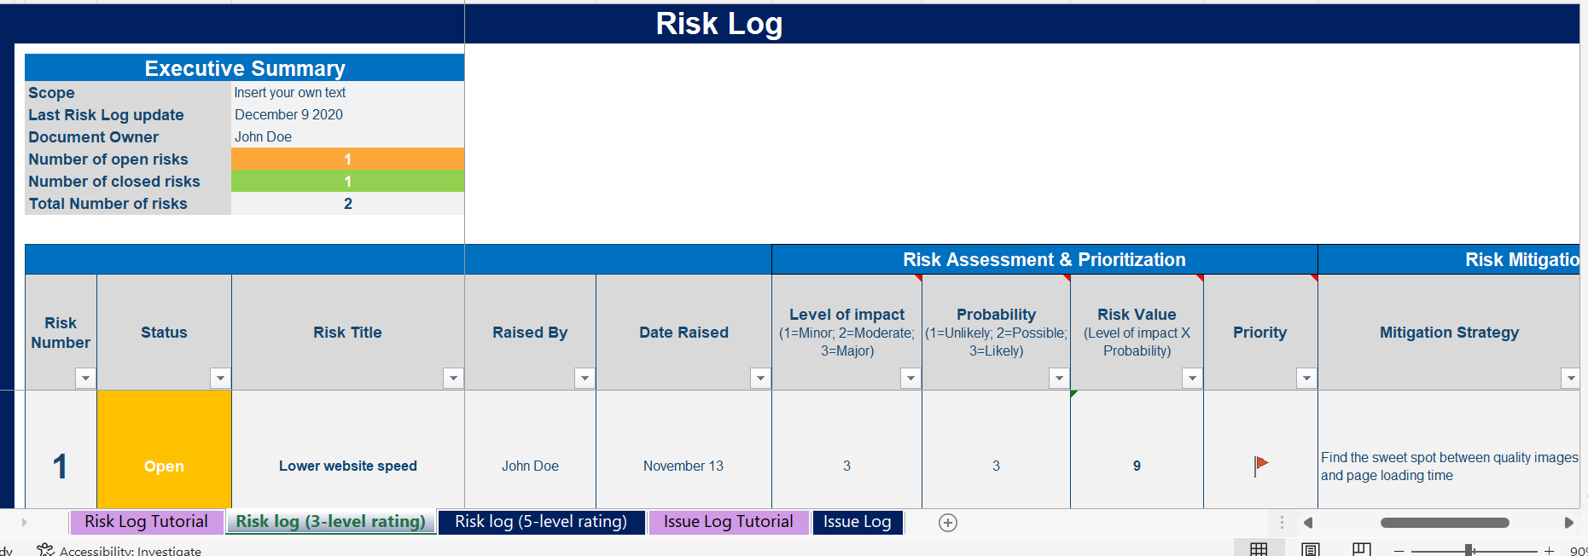
In our comprehensive Risk log in Excel, we also created a 3-level rating and a 5-level rating

Slide 46
Table of contents
1.Risk Management Strategy & Plan
2.Risk Identification
3.Risk Assessment
4.Risk Prioritization
5.Risk Mitigation
6.Risk Closure and Issue Escalation
7. Issue Management
Summary of the corporate and business strategy
Risk appetite
Risk management capability maturity model
Risk management mission, vision and strategic objectives
Risk management KPIs, targets and initiatives
Roadmap to reach our strategic objectives
Risk management team and budget
Governance structure
Guiding principles
Framework to manage risk
Risk types and examples
Tools to identify risks
Simple risk log in Powerpoint
Comprehensive risk log in Excel
Probability of the risk to happen
Potential impact of the risk
Risk value
3 by 3 risk prioritization matrix in Powerpoint and Excel
5 by 5 risk prioritization matrix in Powerpoint and Excel
Response options
Examples
Actions, deadlines and responsibilities
Dashboard
Risk closure
Issue escalation
Simple issue log in Powerpoint
Comprehensive issue log in Excel

Slide 47
Define for each risk your risk mitigation strategy
The objectives of our risk mitigation strategy should be to:
Decrease the probability of the risk to happen or, if possible, totally remove the likelihood of the risk to happen
Decrease the level of impact of the risk
Our risk mitigation strategy should include:
Clear actions on what needs to be done
A deadline on when the actions needs to be implemented
A person responsible for mitigating the risk
Both our Simple Risk Log in Powerpoint and our Comprehensive Risk Log in Excel include a risk mitigation strategy section that we can use throughout our organization.

Slide 48
We identified 5 principles to help us mitigate risks
A mitigation strategy should provide the maximum possible change to the risk exposure for the least investment
Mitigation strategies should be recorded on the Risk log
Important to document any residual risk remaining after the implementation of the mitigation strategy
Important to identify and describe any secondary risks that may be caused by the implementation of the mitigation strategy
There are 6 types of mitigation strategies: (1) Avoid a threat, (2) Reduce a threat, (3) transfer the risk, (4) share the risk, (5) accept the risk or (6) prepare a contingency plan (see more details on the next slide)

Slide 49
We identified 6 types of mitigation strategies
Avoid a threat
This option is about making the uncertain situation certain by removing the risk, often by removing the cause of the threat
Reduce a threat
This option is about taking action now to change the probability and/or impact of a threat
Transfer the risk
This option is about transferring part of the risk to a third-party (e.g. taking an insurance policy)
Share the risk
This option is about sharing the risk with another entity or multiple entities, in order to minimize the potential impact on one single entity
Accept the risk
This option means that the organisation decides to accept that a risk may occur, and decides to take no action, exposing itself to the full possible impact
Prepare a contingency plan
This option means that the organisation decides to accept that a risk may occur, and decides to take no immediate action, but puts in place a series of contingencies to deal with the potential impact

Slide 50
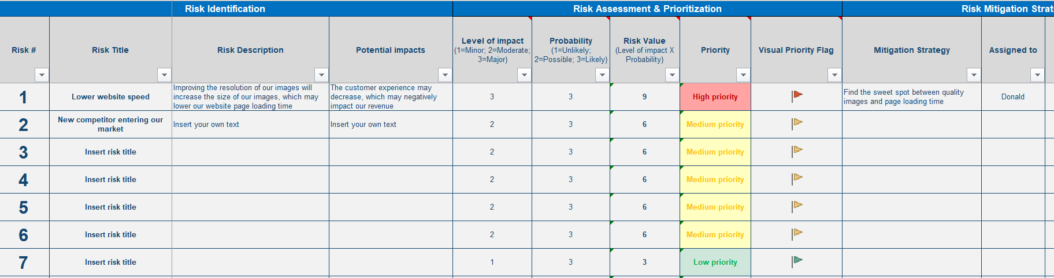
We will define and implement our mitigation strategies by using our comprehensive risk log in Excel

Slide 51
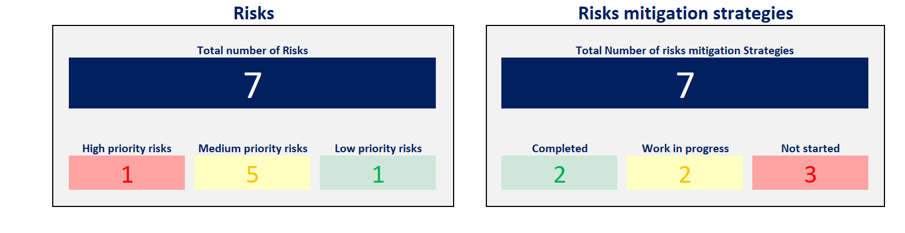
We will monitor the implementation of our mitigation strategies by leveraging our Dashboard in Excel, which will automatically be updated based on the input we make in the Risk log

Slide 52
Table of contents
1.Risk Management Strategy & Plan
2.Risk Identification
3.Risk Assessment
4.Risk Prioritization
5.Risk Mitigation
6.Risk Closure and Issue Escalation
7. Issue Management
Summary of the corporate and business strategy
Risk appetite
Risk management capability maturity model
Risk management mission, vision and strategic objectives
Risk management KPIs, targets and initiatives
Roadmap to reach our strategic objectives
Risk management team and budget
Governance structure
Guiding principles
Framework to manage risk
Risk types and examples
Tools to identify risks
Simple risk log in Powerpoint
Comprehensive risk log in Excel
Probability of the risk to happen
Potential impact of the risk
Risk value
3 by 3 risk prioritization matrix in Powerpoint and Excel
5 by 5 risk prioritization matrix in Powerpoint and Excel
Response options
Examples
Actions, deadlines and responsibilities
Dashboard
Risk closure
Issue escalation
Simple issue log in Powerpoint
Comprehensive issue log in Excel

Slide 53
There are mainly 2 reasons to close a Risk
The implementation of your risk mitigation strategy worked, and the risk value is now very low or equal to zero.
Despite your risk mitigation strategy, the risk became a real issue. In this situation, you need to close the risk and create an “issue” and manage it using one of these 2 Issue Logs presented in the next slide.

Slide 54
Table of contents
1.Risk Management Strategy & Plan
2.Risk Identification
3.Risk Assessment
4.Risk Prioritization
5.Risk Mitigation
6.Risk Closure and Issue Escalation
7. Issue Management
Summary of the corporate and business strategy
Risk appetite
Risk management capability maturity model
Risk management mission, vision and strategic objectives
Risk management KPIs, targets and initiatives
Roadmap to reach our strategic objectives
Risk management team and budget
Governance structure
Guiding principles
Framework to manage risk
Risk types and examples
Tools to identify risks
Simple risk log in Powerpoint
Comprehensive risk log in Excel
Probability of the risk to happen
Potential impact of the risk
Risk value
3 by 3 risk prioritization matrix in Powerpoint and Excel
5 by 5 risk prioritization matrix in Powerpoint and Excel
Response options
Examples
Actions, deadlines and responsibilities
Dashboard
Risk closure
Issue escalation
Simple issue log in Powerpoint
Comprehensive issue log in Excel

Slide 55

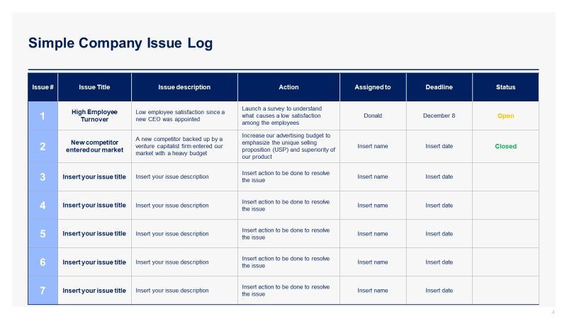
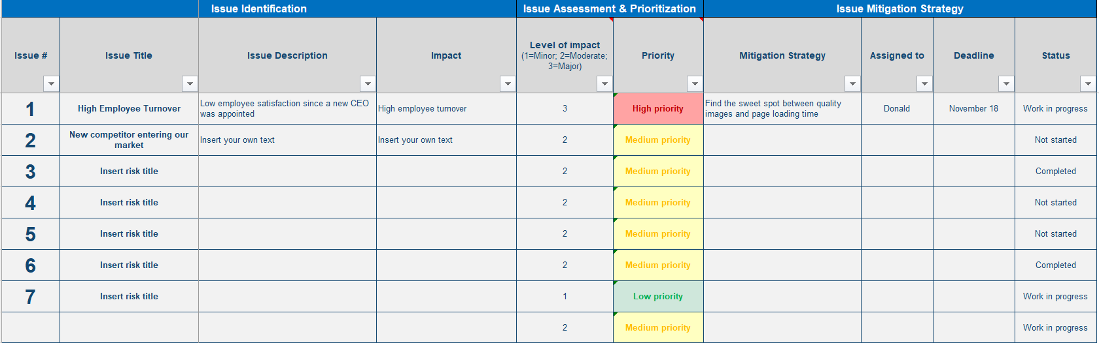
To manage our issue efficiently, you created a simple and comprehensive issue log
Simple Issue Log (see next slide)
Comprehensive Issue Log (see Excel document)
The Simple Issue Log in Powerpoint is great if your list of issues is small or if you need to make a presentation in front of your Board of Directors, Executive Committee or any stakeholders that do not need to know too many details.
The Comprehensive Issue Log in Excel is great if you have a long list of issues and need to provide a lot of details for each one of them.
Our clients usually like to use both: They prefer to use the Comprehensive Issue Log in Excel during working sessions with their team. However, when they need to provide a high-level view to their leadership team or key stakeholders, they prefer to highlight the top 5 issues they identified using the Simple Issue Log in Powerpoint.

Slide 56
Simple Issue Log
Issue # | Issue Title | Issue description | Action | Assigned to | Deadline | Status
1 | High Employee Turnover | Low employee satisfaction since a new CEO was appointed | Launch a survey to understand what causes a low satisfaction among the employees | Donald | December 8 | Open
2 | New competitor entered our market | A new competitor backed up by a venture capitalist firm entered our market with a heavy budget | Increase our advertising budget to emphasize the unique selling proposition (USP) and superiority of our product | Insert name | Insert date | Closed
3 | Insert your issue title | Insert your issue description | Insert action to be done to resolve the issue | Insert name | Insert date
4 | Insert your issue title | Insert your issue description | Insert action to be done to resolve the issue | Insert name | Insert date
5 | Insert your issue title | Insert your issue description | Insert action to be done to resolve the issue | Insert name | Insert date
6 | Insert your issue title | Insert your issue description | Insert action to be done to resolve the issue | Insert name | Insert date
7 | Insert your issue title | Insert your issue description | Insert action to be done to resolve the issue | Insert name | Insert date

Slide 57
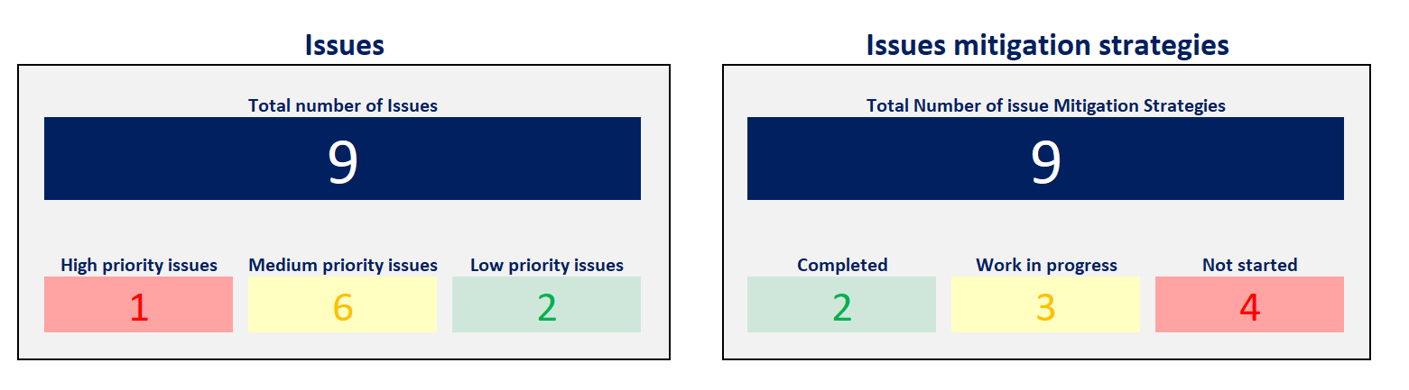
We will monitor the implementation of our mitigation strategies by leveraging our Dashboard in Excel, which will automatically be updated based on the input we make in the Issue log

Slide 58

Interested in more than 1 Toolkit? Access all our Toolkits for half the price with our Gold Access
Gold Access
Click here to learn more

Slide 59
Thanks for your attention!
www.domontconsulting.com

